Slide 1

Vehicle Fuel Analysis
Capstone II by Allison Lawrence

Slide 2

Data Background Information
The data used was from the United States Environmental Protection Agency
The data includes car information based on year make model, class and other indicators of car type.
As well as information based on fuel type used, gas mileage, CO2 emissions and other environmental impact indicators.

Slide 3
Project Goal
Most cars in the data set run on regular gasoline.
Fuel Type | Count of Fuel Type | Fuel Type Usage Percent
Regular | 25,258 | 66.27%
Premium | 10,133 | 26.59%
Gasoline or E85 | 1,223 | 3.21%
Diesel | 1,014 | 2.66%
Electricity | 133 | 0.35%
Premium or E85 | 122 | 0.32%
Midgrade | 77 | 0.20%
CNG | 60 | 0.16%
Premium and Electricity | 25 | 0.07%
Regular Gas and Electricity | 20 | 0.05%
Gasoline or natural gas | 20 | 0.05%
Premium Gas or Electricity | 18 | 0.05%
Gasoline or propane | 8 | 0.02%
Regular Gas or Electricity | 2 | 0.01%

Slide 4
Project Goal
Of those cars the most popular drives are Front-Wheel and Rear-Wheel Drive.
Filter: Fuel Type | :Regular
Drive | Count of Drive | % of Drive
Front-Wheel Drive | 10,507 | 41.6%
Rear-Wheel Drive | 7,190 | 28.5%
4-Wheel or All-Wheel Drive | 4,784 | 18.9%
All-Wheel Drive | 751 | 3.0%
4-Wheel Drive | 466 | 1.8%
2-Wheel Drive | 420 | 1.7%
Part-time 4-Wheel Drive | 117 | 0.5%
Data Unavailable | 1,023 | 4.1%
Grand Total | 25,258 | 100%

Slide 5

Project Goal
Of the cars that run on regular gasoline, what impact does Front-Wheel Drive vs. Back-Wheel drive have on:
Annual Fuel Cost
Fuel Economy Score

Slide 6
Note on Fuel Economy Score
According to the United States Environmental Protection Agency
“The label assigns each vehicle a rating from 1 (worst) to 10 (best) for fuel economy…”
“Consumers may note that higher fuel economy is associated with a better Green House Gas emissions profile.”
“… greenhouse gas emissions (i.e., how much carbon dioxide the vehicle’s tailpipe emits each mile).”

Slide 7

Hypotheses
Null Hypothesis 1 (H₀):
No difference in annual fuel cost between Front-Wheel drive and Rear-Wheel drive cars using regular gasoline.
Alternate Hypothesis 1 (H_{a}):
There is a difference in annual fuel cost between Front-Wheel drive and Rear-Wheel drive cars using regular gasoline.
________________________________________
Null Hypothesis 2 (H₀):
No difference in Fuel Economy Score between Front-Wheel drive and Rear-Wheel drive cars that use regular gasoline.
Alternate Hypothesis 2 (H_{a}):
There is a difference in Fuel Economy Score between Front-Wheel drive and Rear-Wheel drive cars that use regular gasoline.

Slide 8
Process
Isolate the data pertaining to cars operating on regular gasoline.
Narrow down to Front-Wheel and Rear-Wheel Drive.
Consolidate the data based on:
Annual Fuel Cost
Fuel Economy Score

Slide 9
Process
Check for Normal Distribution
Run t-tests to see if there is any statistically significant difference between Front-Wheel drive and Rear-Wheel drive cars using regular gasoline on:
Annual Fuel Cost
Fuel Economy Score

Slide 10
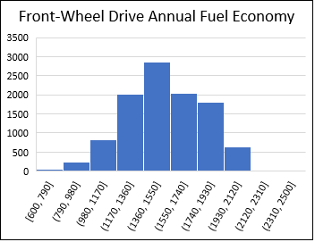
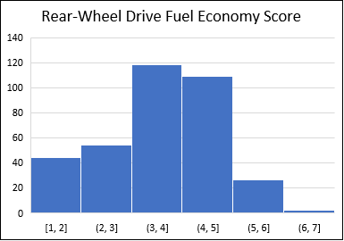
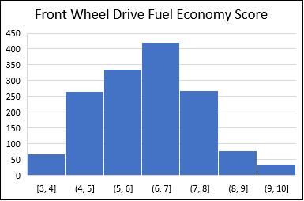
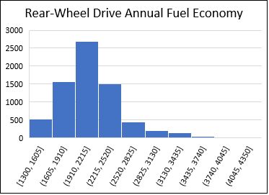
Analysis
The data variables were normally distributed, so it is reasonable to use the t-test results.

Slide 11
Analysis of Annual Fuel Cost
Reject the Null
There is a significant difference between Front-Wheel drive and Rear-Wheel.
With 95% confidence, the difference on annual fuel cost is between -$644.5 and -$622.5.
Of the cars that use regular fuel, Front-Wheel drive cars fuel, costs less annually than Rear-Wheel drive cars.

Slide 12
Analysis of Fuel Economy Score
Reject the Null
There is a significant difference between Front-Wheel drive and Rear-Wheel drive.
With 95% confidence, the difference in fuel economy score is between 2.48 and 2.78.
Of the cars that use regular fuel, Front-Wheel drive cars have better fuel economy scores than Rear-Wheel drive cars. This makes them more environmentally friendly.

Slide 13

Final Message and Recommendations
The Statistical Analysis shows that of the cars using regular gasoline, Front-Wheel drive and Rear-Wheel drive does have a significant impact on:
Annual Fuel Cost
Fuel Economy Score
Recommendations
For customers looking for cars that primarily use regular gasoline, recommend a car that uses Front-Wheel drive as they will spend less annually on fuel, and it is more environmentally friendly.
Note: Works for locations that don’t require All-Wheel drive. (Snow)
For reference, analysis workbook is here.

Slide 14

Questions

